Slide 1
EL MONTE UNION HIGH SCHOOL DISTRICT
BOND & FACILITIES UPDATE
=
September 2024

Slide 2
Measure D Bond- $148 Million
2008 Election
Bond Series | Issue Date | Principal Amount
Series A | 6/16/2009 | $ 54,001,305.
Series B | 6/02/2011 | $ 30,000,000.
Series C | 4/08/2016 | $ 5,238,885.
Series D | 11/21/2017 | $ 10,196,955.
Series E | 8/18/2021 | $ 33,496,221.
Series F (Final Sale) | 6/04/2024 | $ 13,778,540.
Total Issue Amount |  | $146,711,906.
Cost of Bond Issuance |  | $ (2,098,785).
*Transfer in from other fund |  | $ 12,991,157.
Interest as of June 30, 2024 |  | $ 3,447,289.
Total Revenue |  | $161,051,567.
Audit Adjustment / Fair Value |  | $ (1,793,400).
Total Expended as of June 30, 2024 |  | $(133,796,281).
Balance |  | $ 25,461,886.
*Reimbursements from State Match Funds, City of Rosemead, E-Rate & DGS

Slide 3
Measure HS Bond- $190 Million 2018 Election
Bond Series | Issue Date | Principal Amount
Series A | 6/04/2019 | $ 56,065,000.
Series B | 8/18/2021 | $ 53,484,500.
Series C | 6/04/2024 | $ 19,730,000.
Total Issue Amount |  | $129,279,500.
Cost of Bond Issuance |  | $ (928,514).
Other Revenue |  | $ 1,023,730.
Interest as of June 30, 2024 |  | $ 4,087,875.
Total Revenue |  | $133,462,591.
Audit Adjustment/Fair Value |  | $ (2,891,524).
Total Expended as of June 30, 2024 |  | $ (66,637,368).
Balance |  | $ 63,933,699.

Slide 4
Project List & Funding Sources
Project | Estimated Budget | Bond | State Fund 35 | Fund 25 | Fund 14 | ESSER | S & C | Other Funds
Arroyo Track & Field | $15,000,000. | $14,750,000. |  | $250,000.
Arroyo Modernization | $37,500,000. | $27,255,237. | $7,404,172. |  | $1,000,000. | $1,840,591.
El Monte Track & Field | $8,000,000. | $8,000,000.
El Monte Modernization | $40,000,000. | $27,134,704. | $10,360,844. |  | $1,000,000. | $1,504,452.
Mountain View Track & Field | $17,000,000. | $16,750,000. |  | $250,000.
Mountain View Modernization | $30,000,000. | $28,023,578. | $976,422. |  | $1,000,000.
Rosemead Modernization | $45,000,000. | $30,173,161. | $13,000,000. |  | $1,000,000. | $826,839.
South El Monte Track & Field | $15,000,000. | $15,000,000.
South El Monte Modernization | $42,000,000. | $25,744,475. | $9,086,028. |  | $1,000,000. | $6,169,497.

Slide 5
Project List & Funding Sources
Project | Estimated Budget | Bond | State Fund 35 | Fund 25 | Fund 14 | ESSER | S & C | Other
Adult/Transition Center | $23,000,000. | $18,587,207. | $2,000,000. (Estimate) |  |  | $412,793. |  | $2,000,000 (Adult Ed.)
PDC Modernization | $2,780,202. |  |  |  |  |  | $2,780,202
Battery Storage | $6,033,670 | $1,131,442. |  |  |  |  |  | $3,804,500.
District Wide |  |  |  |  |  |  |  | CARB Grant $1,097,728.
 |  |  |  |  |  |  |  | SCE SGIP
TOTAL | $281,313,872. | $212,549,804. | $42,827,466. | $500,000. | $5,000,000. | $10,754,172. | $2,780,202. | $6,902,228.
Fund 35 = State Matching
Fund 25 = Developer Fund
Fund 14 = Deferred Maintenance
S & C= Supplemental & Concentration

Slide 6
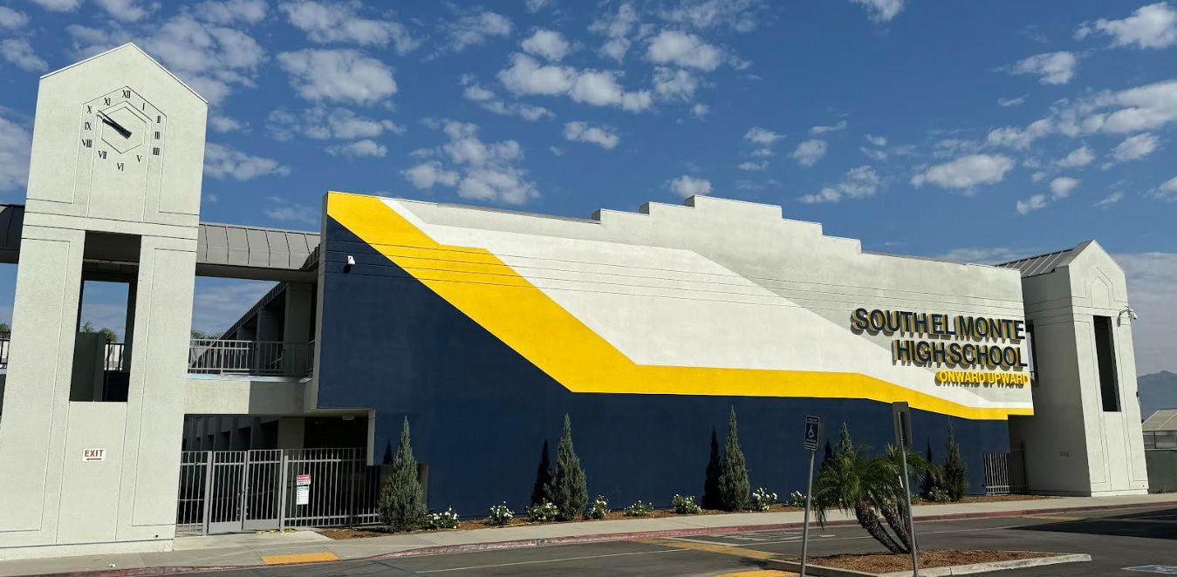
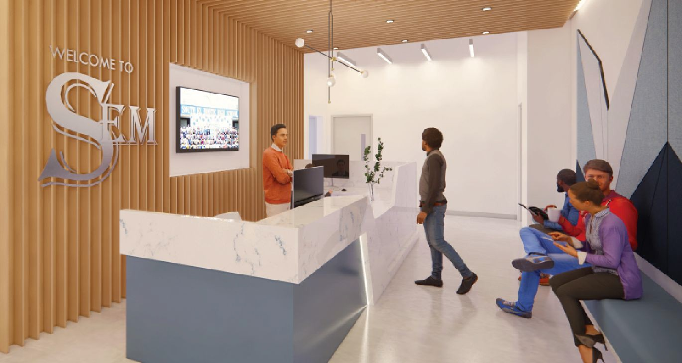
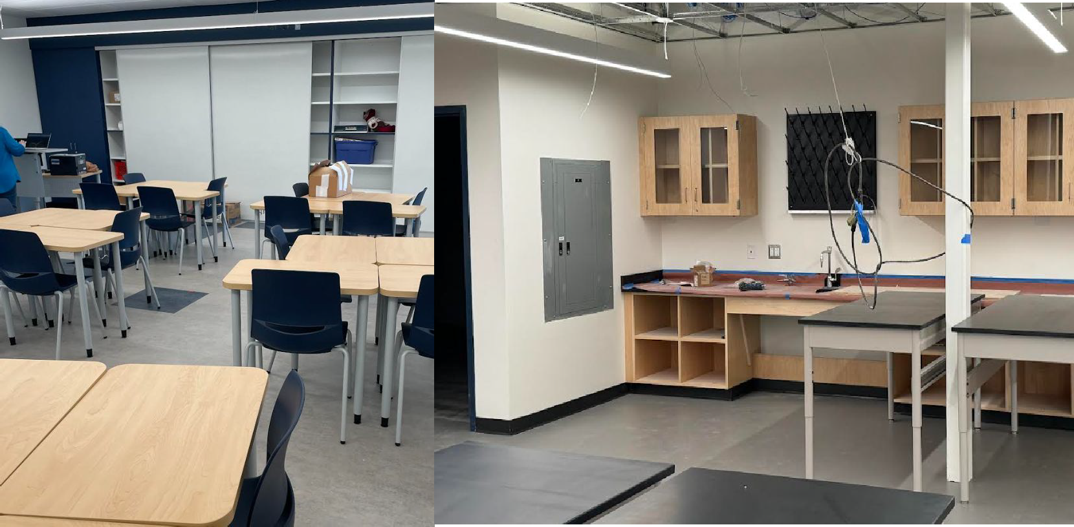
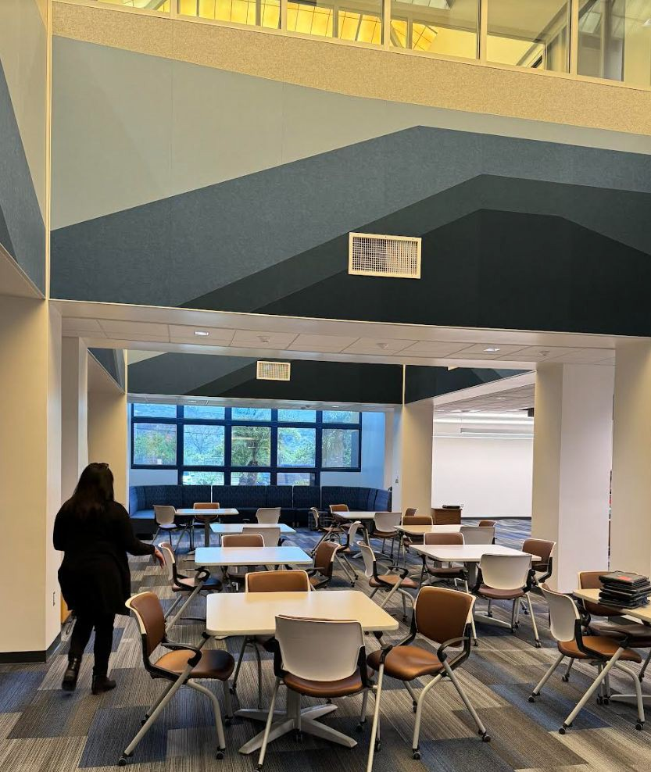
South El Monte High School Modernization
Board approved DLR Group to work on Modernization Project on June
DLR has had many meeting with key stakeholders to identify the priority projects
Board approved Erickson Hall for Construction Managers of project
Project commenced in January 2023
Project is currently under construction
Will be completed in phases
Improvements Include“:
2020
Classroom modernization including new flooring, wall finishes, ceiling & lighting
Improvements in Library
New Career Technology Classroom improvements
Infrastructure improvements including exterior painting, roofing,
plumbing, security Project is being reviewed by DSA
◻ Project will be completed October 2024

Slide 7
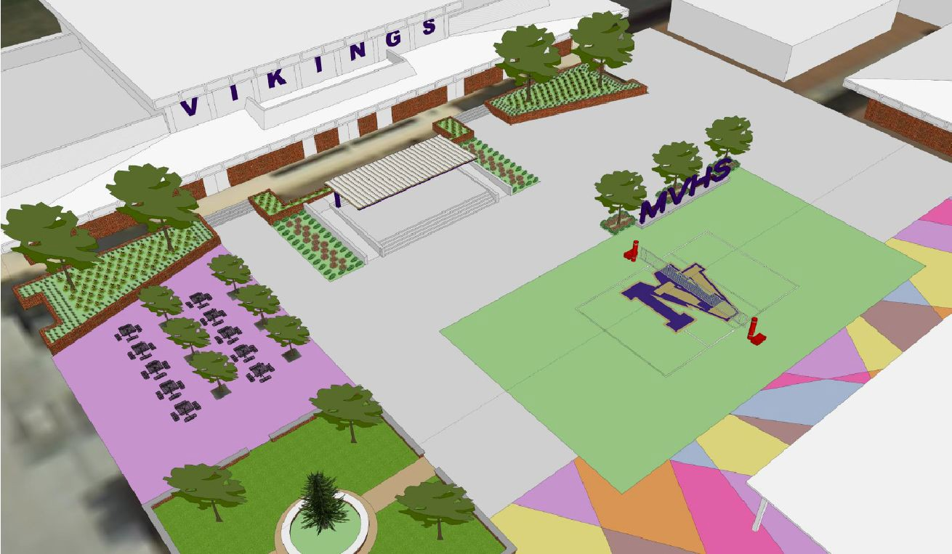
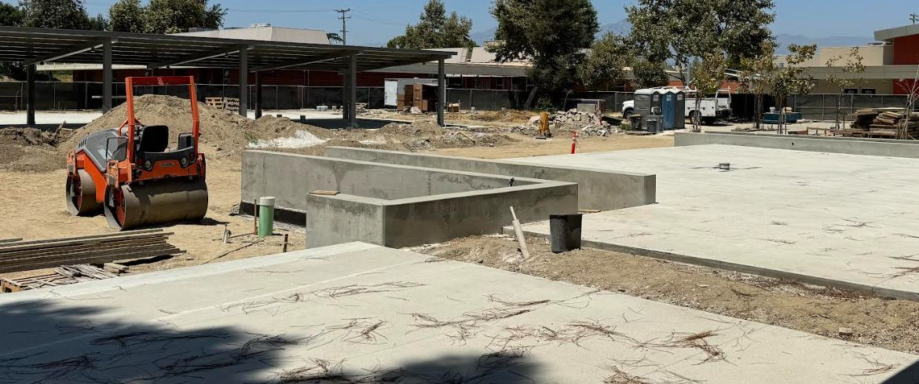
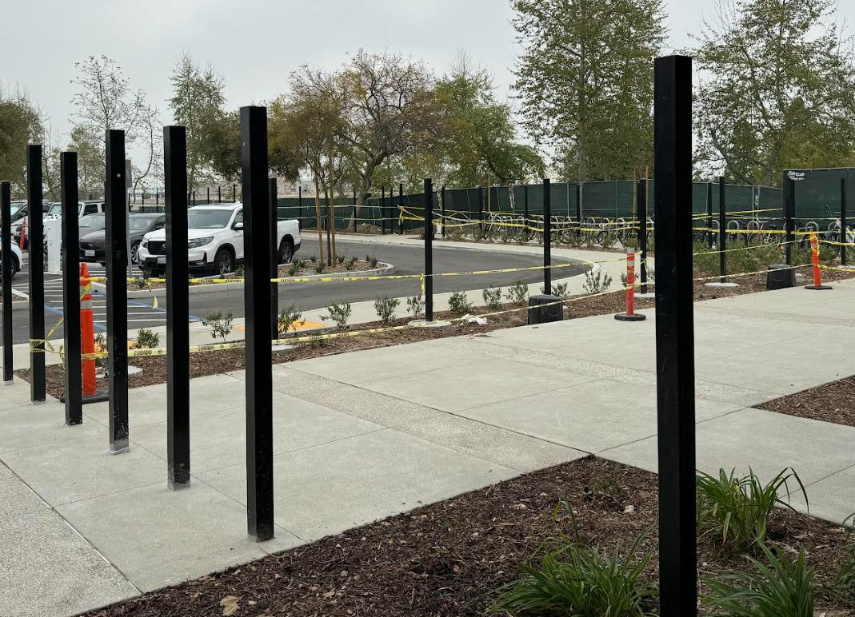
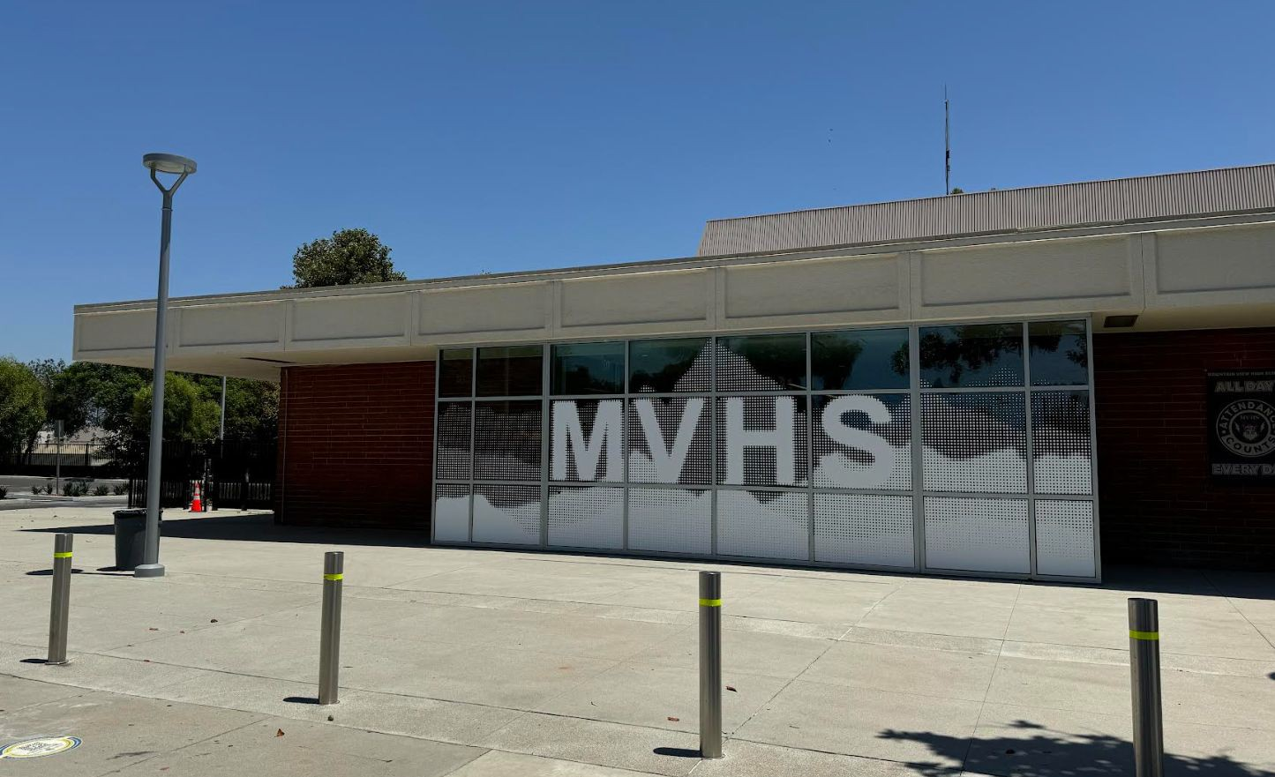
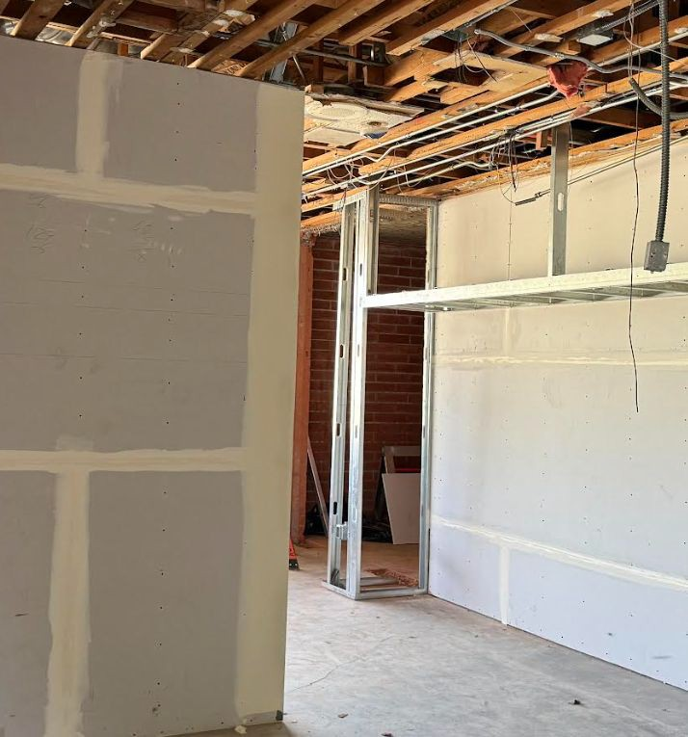
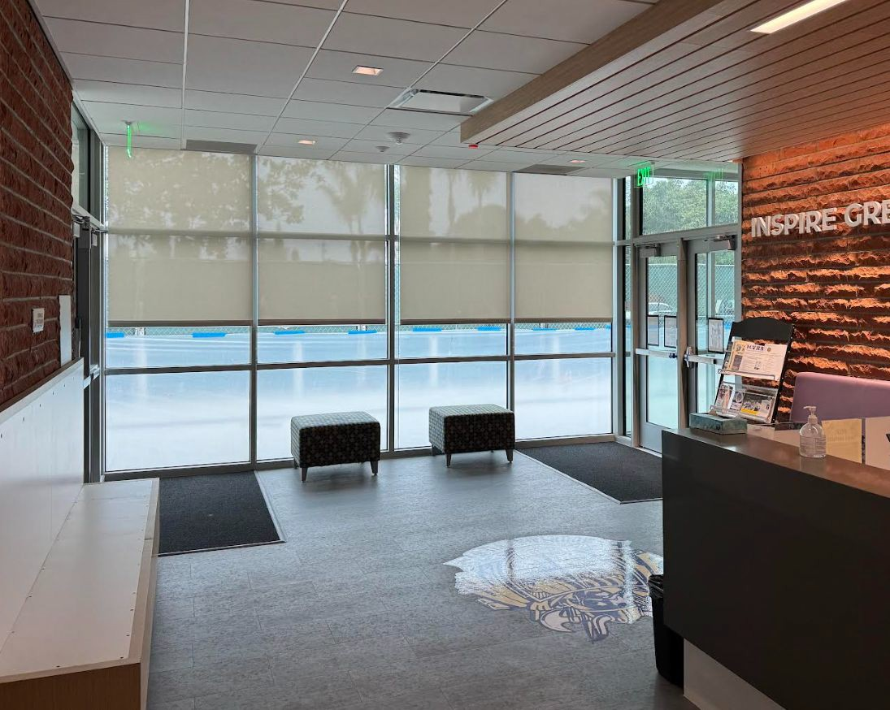
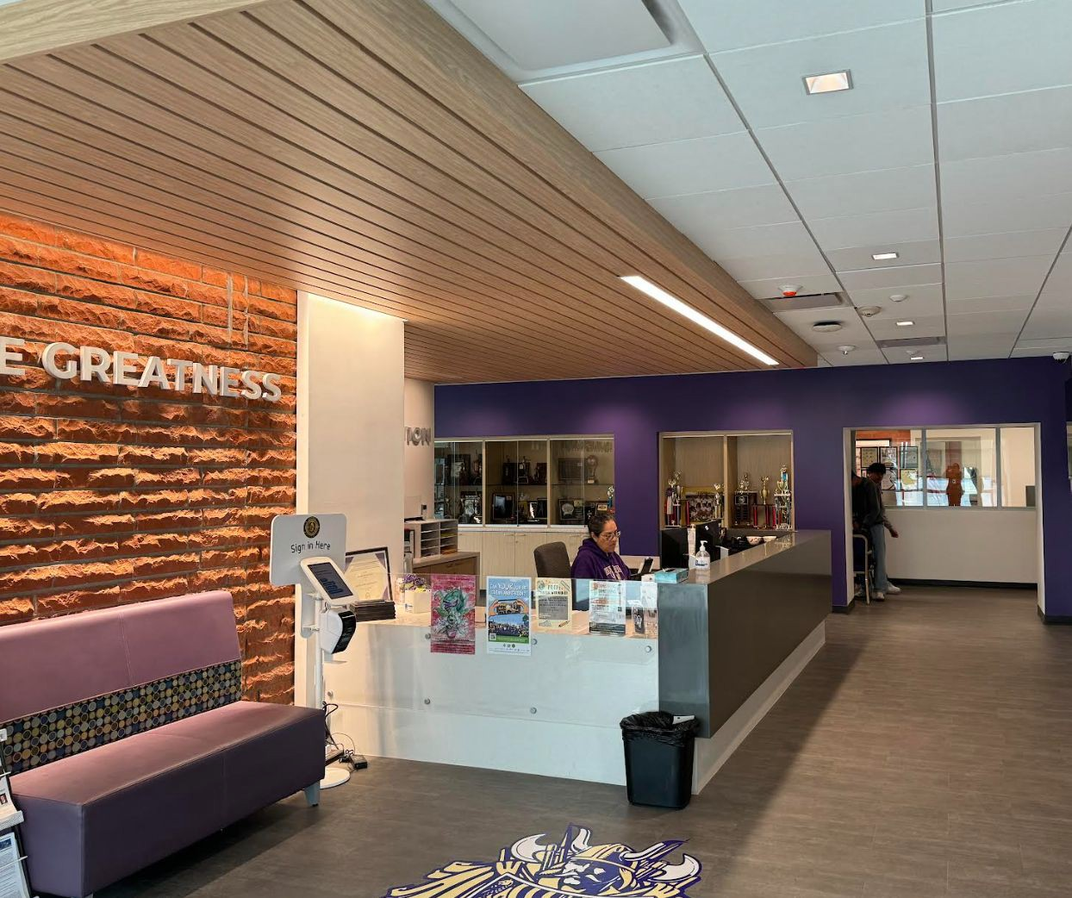
Mountain View High School Modernization
◻ Board approved LPA Architects to work on
Modernization Project on May 2020
◻ LPA has had many meeting with key stakeholders
to identify the priority projects
◻ LPA presented list of Modernization projects to
Board on April 14, 2021
◻ LPA finalizing construction documents and
preparing to submit in April
◻ Board approved Telacu as Construction Managers
for this project
Project has been submitted to DSA for approval
Project obtained DSA approval in January 2023
Modernization projects will include:
Curb Appeal/Site access
Quad and other exterior enhancement
projects
◻ Building K building modernization (science
labs)
Improvements in Building B
Softball/Baseball field improvements
Girls locker room improvements
Infrastructure improvements such as
roofing/Fire alarm, plumbing
Project is 59 % Complete
Project will be completed March 2025

Slide 8
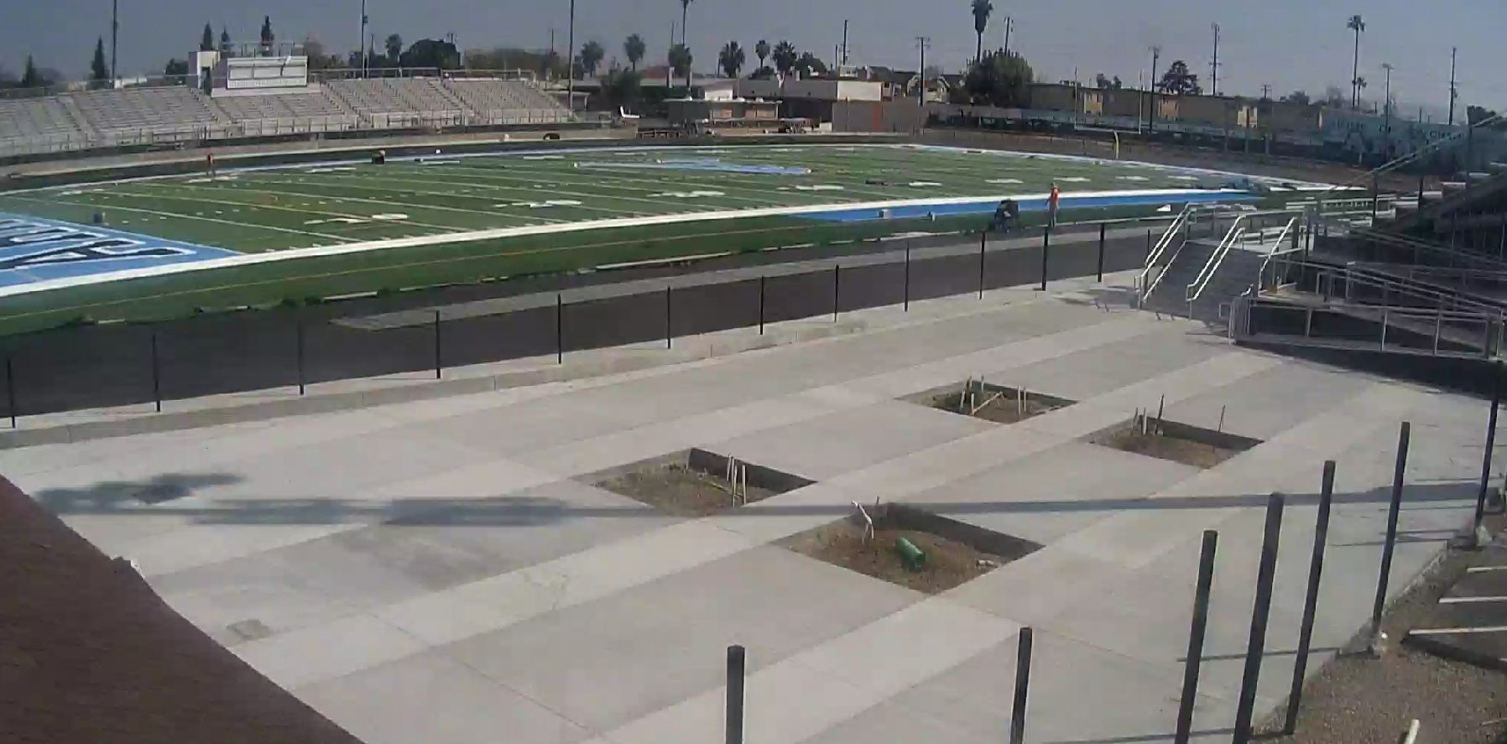
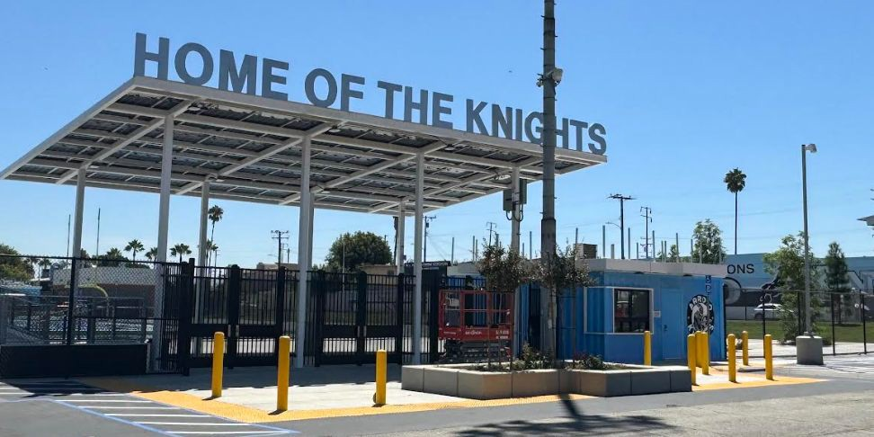
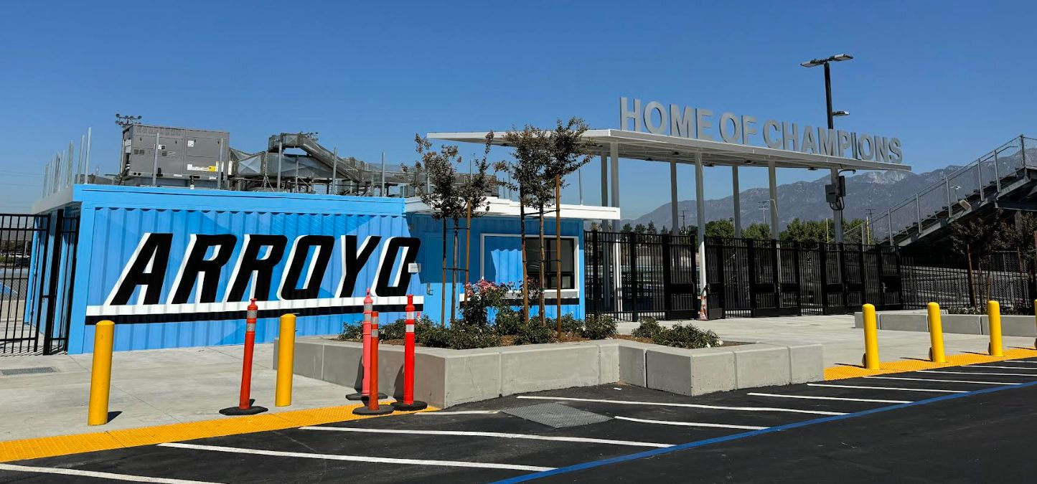
Arroyo High School Track and Field Project
HMC Architects hired to design all track & field projects
HMC has met with stakeholders and hosted site visits to explore different synthetic field types
Construction to started in January 2023
Ribbon Cutting was in May 23, 2024

Slide 9
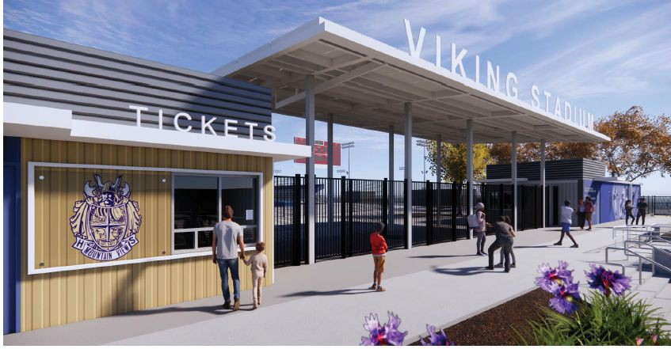
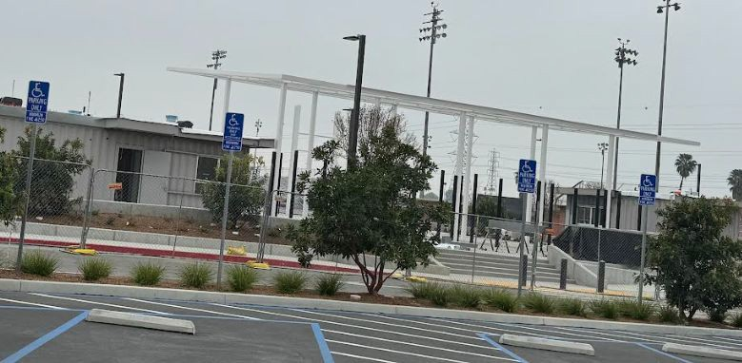
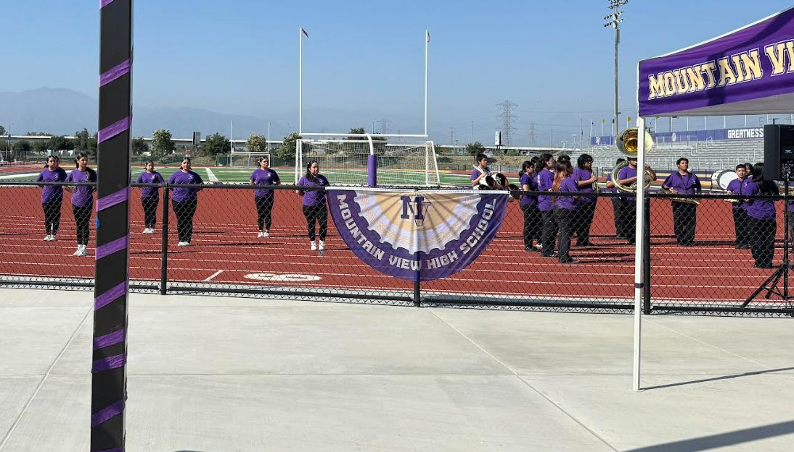
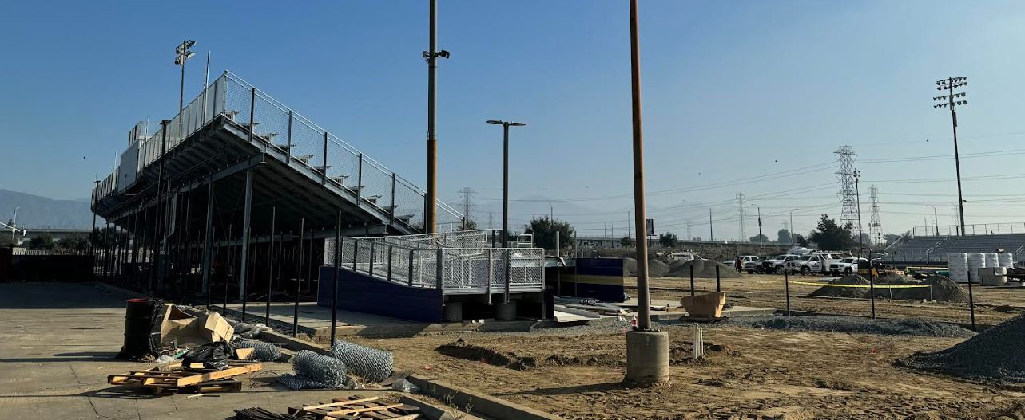
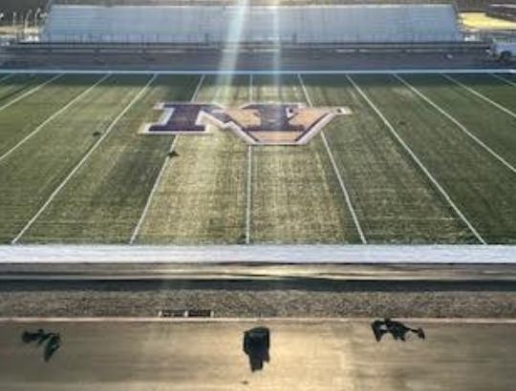
Mountain View High School Track and Field Project
HMC Architects hired to design all track & field projects
HMC has met with stakeholders and hosted site visits to explore different synthetic field types
Project will include new bleachers, snack bars, restrooms, and synthetic track and field
DSA approved plans
Currently bidding project
Board to consider award for project in October 2022
Construction started in November 2022
Ribbon Cutting ceremony was on September 7th

Slide 10
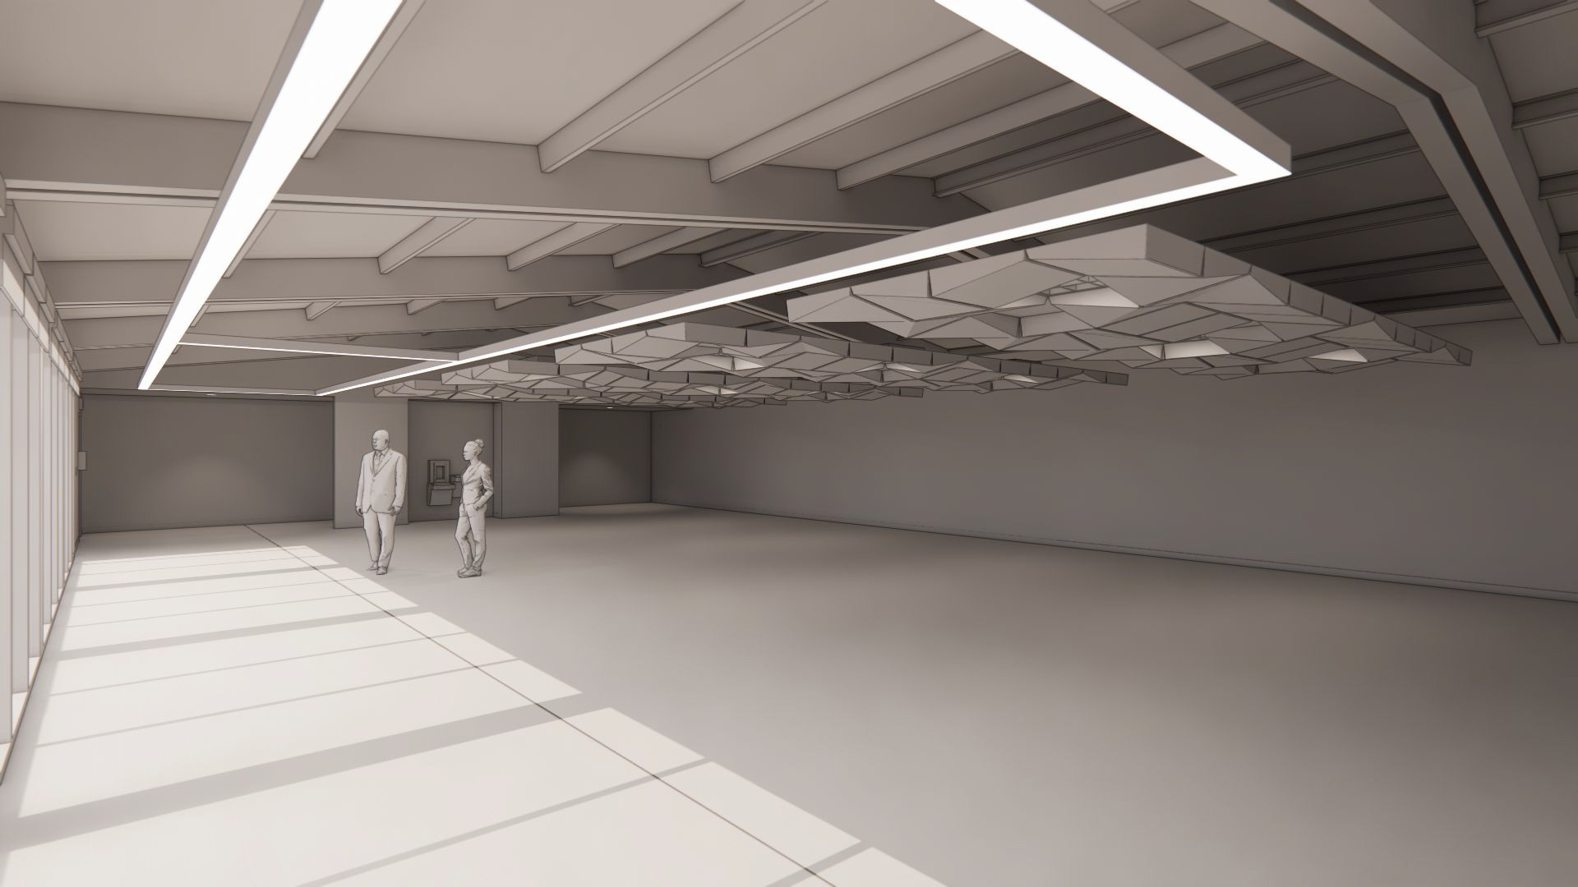
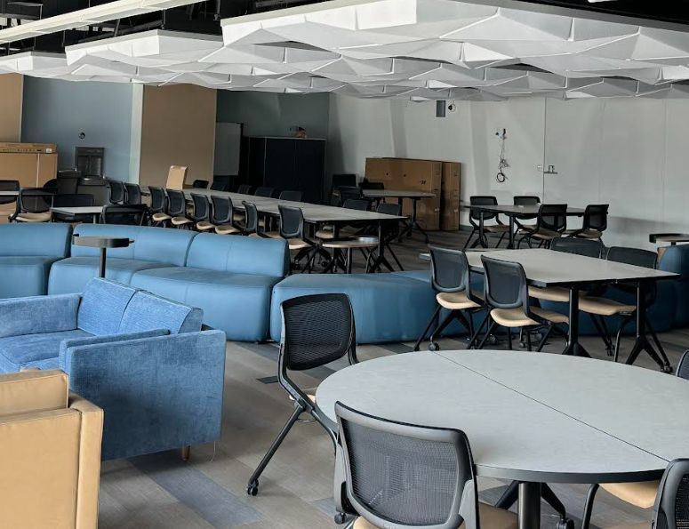
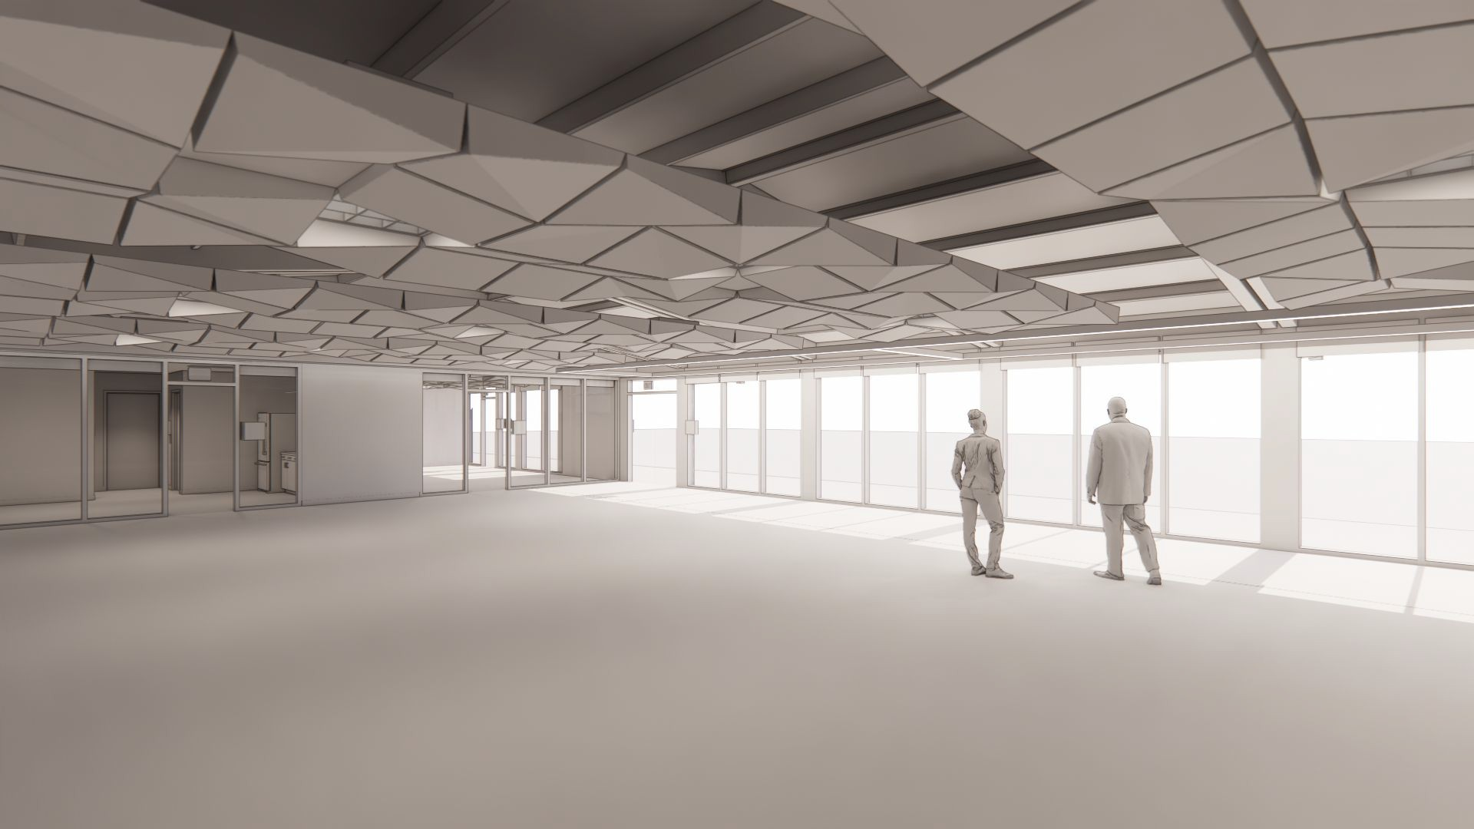
PDC Modernization
EMUHSD Family and Community Center
CSDA Architects hired to design project
Project will include exterior & interior improvements
Improvements include:
New kitchenette area
Restroom access from interior
Addition of glass storefront
Acoustical treatment on ceiling &
Lighting & audio upgrades
elevation
walls
Construction began in January of 2024
Project is 95% and is scheduled to be completed in October

Slide 11
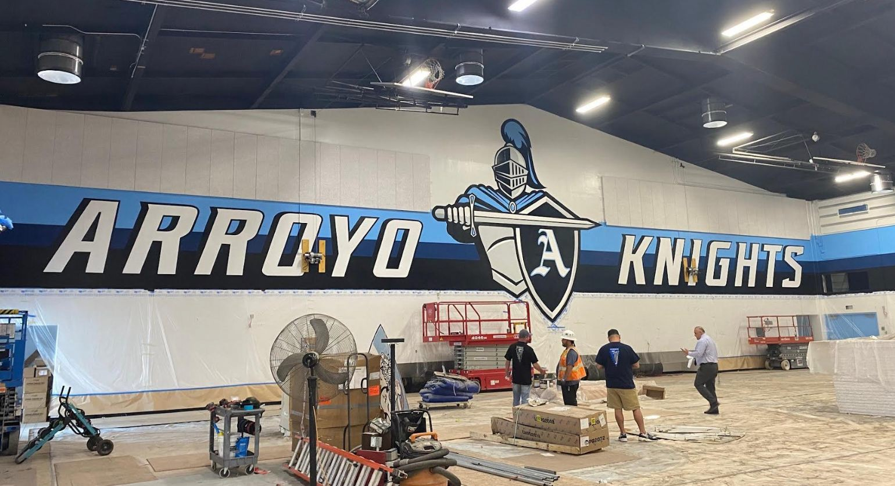
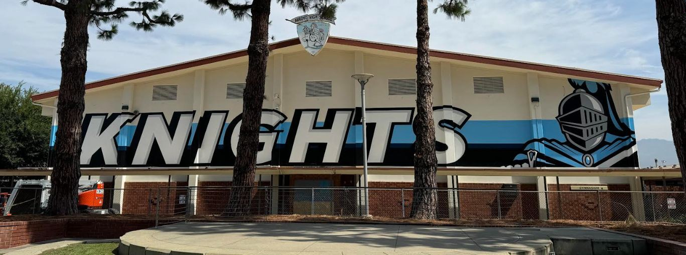
Arroyo – HVAC in Kitchen & Gymnasium
Improvements include:
❏ Minimal repair/replacement of interior building finishes and fixtures
❏ DSA Voluntary Scope of Work
❏ Barrier Removal (accessibility)
❏ New Roof
❏ Painting of Exterior Building
❏ New HVAC System
❏ Minimal Low Voltage
❏ New Fire Alarm Replacement
❏ Keyless Entry System
❏ Replace bleacher’s motor and add handrails
❏ Repair motorized backstops
Project in construction
Will be completed by January 2025

Slide 12
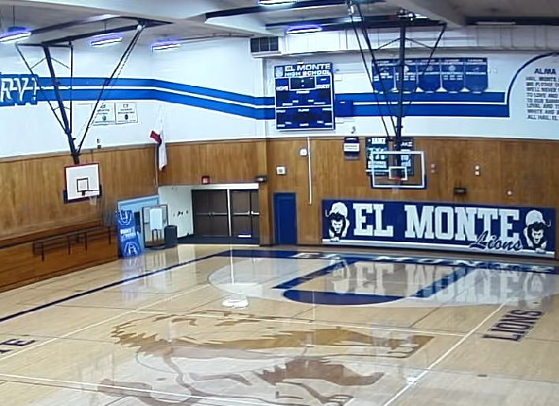
El Monte –HVAC in Kitchen & Gymnasium
Improvements include:
❏ Installation of HVAC in Kitchen & Dining room
❏ Replacement of hood vent
❏ Installation of HVAC in large and small Gymnasium
❏ Minimal repair/replacement of interior building finishes and fixtures
❏ DSA Voluntary Scope of Work
❏ New Roof
❏ New HVAC System
❏ Minimal Low Voltage
❏ New Fire Alarm Replacement
❏ Keyless Entry System
Project is in construction and expected To be completed by February 2025

Slide 13
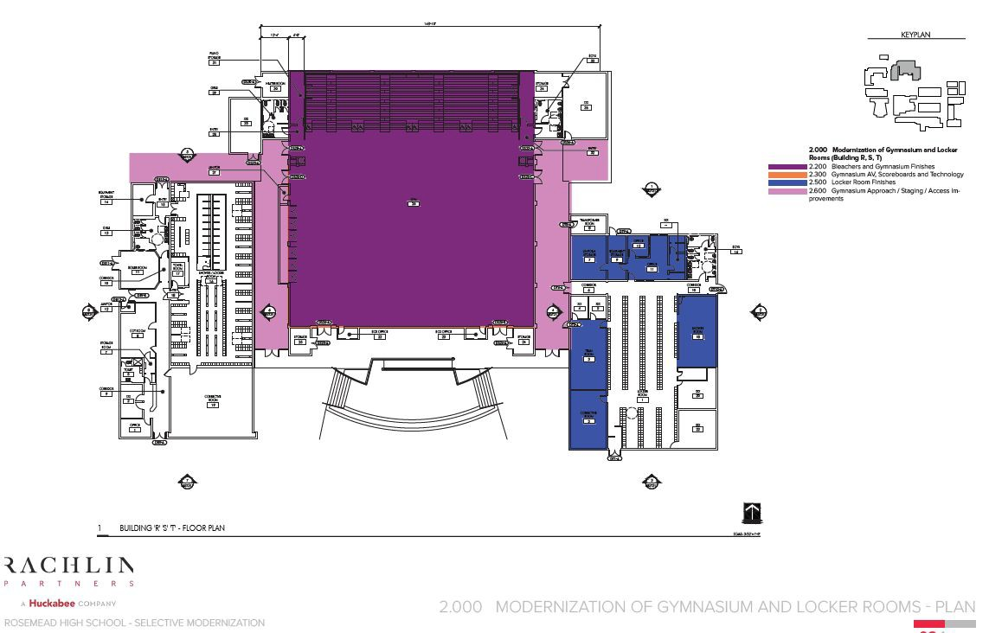
Rosemead –Gymnasium Modernization
Improvements include:
❏ Installation of new heating and cooling (HVAC)
❏ New Roof
❏ New Solatube skylights installed
❏ Painting and finishes
❏ Electrical Upgrades
❏ Fire Alarm Upgrades
Project is 98% Complete. Building has been returned to site for use.

Slide 14
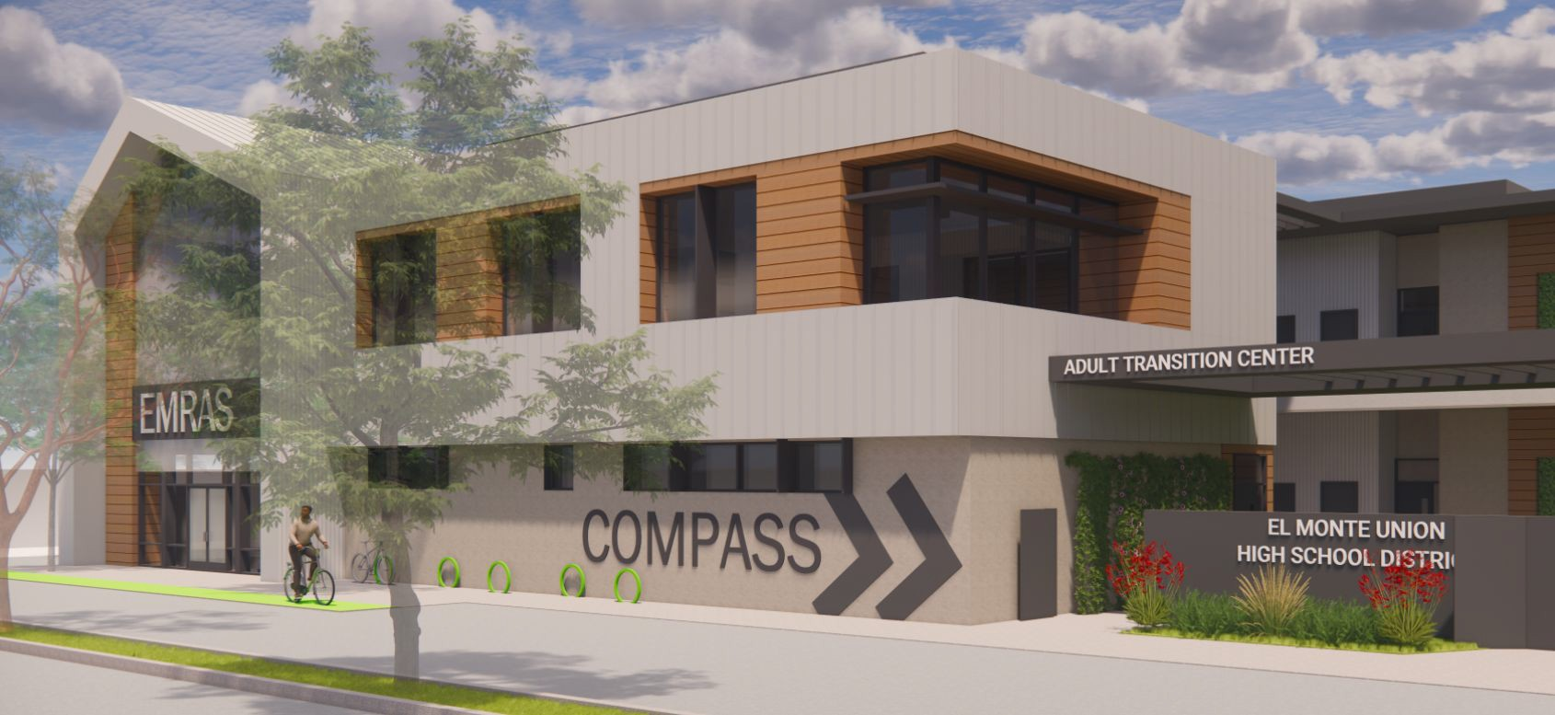
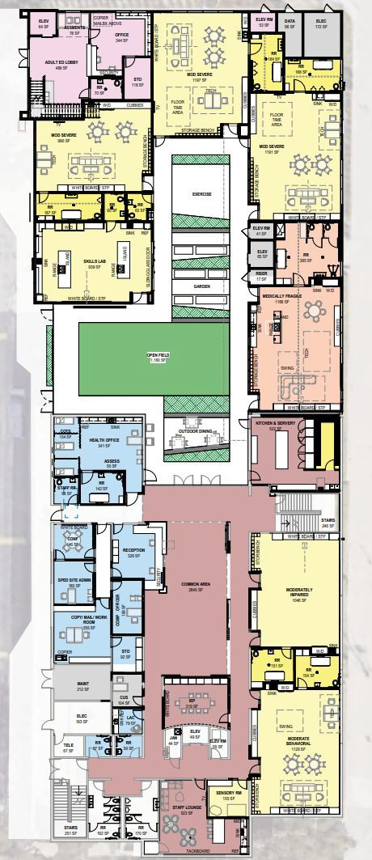
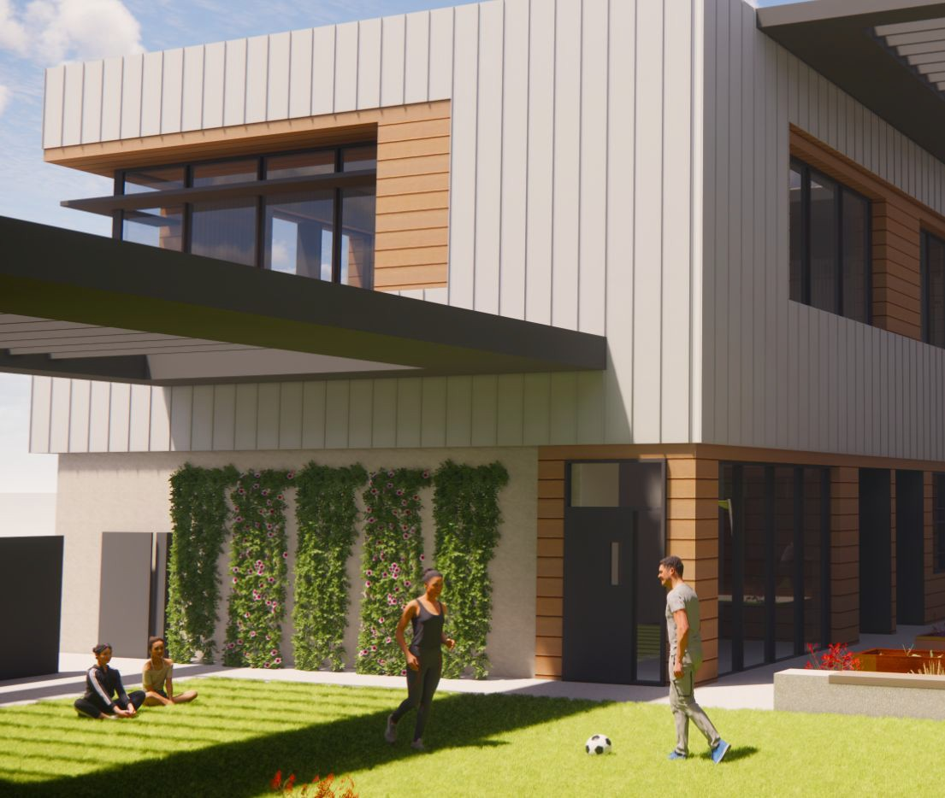
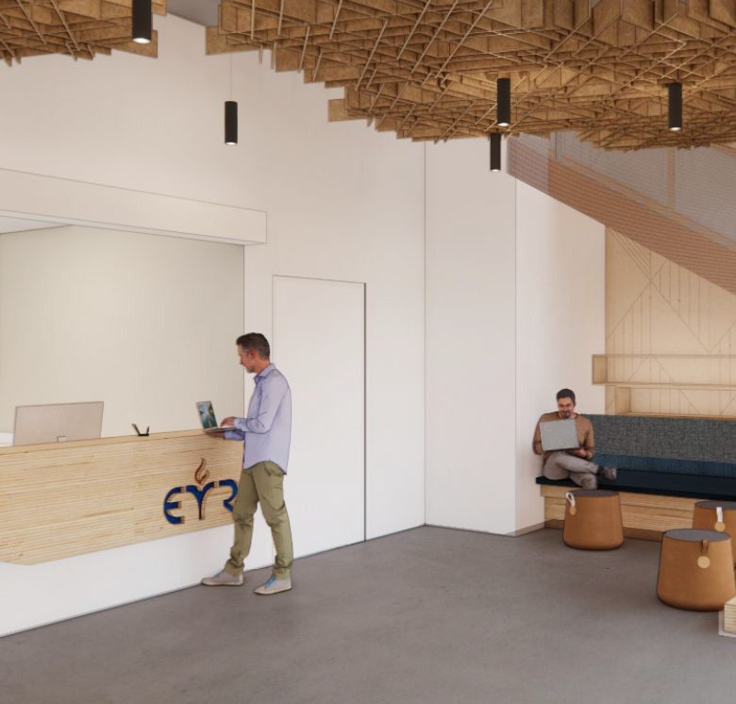
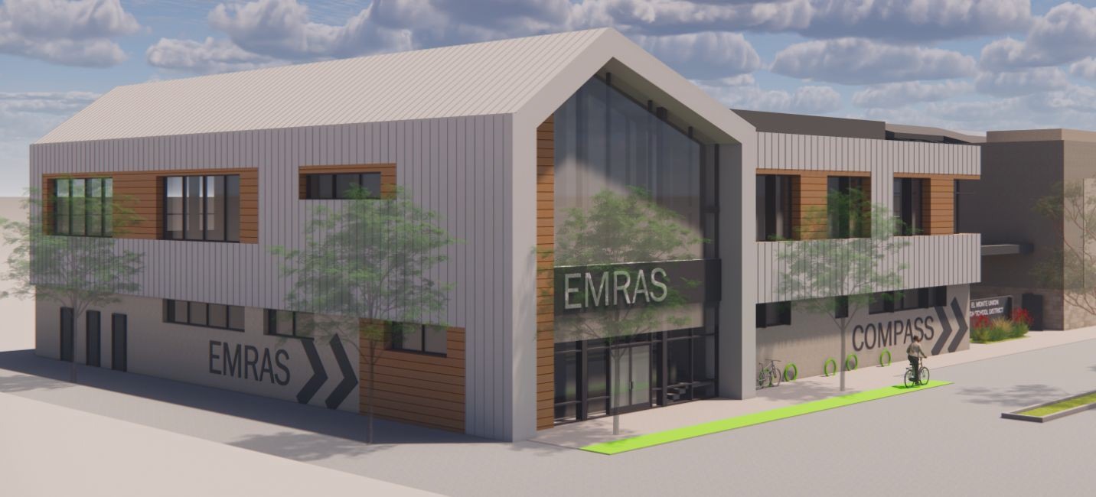
Rosemead Adult Center
Rosemead Adult Center to be modernized and expanded with an addition
Project will house the Adult Transition Program and Adult School servicing the western San Gabriel Valley
Project is currently being bid
Project projected to start January

Slide 15
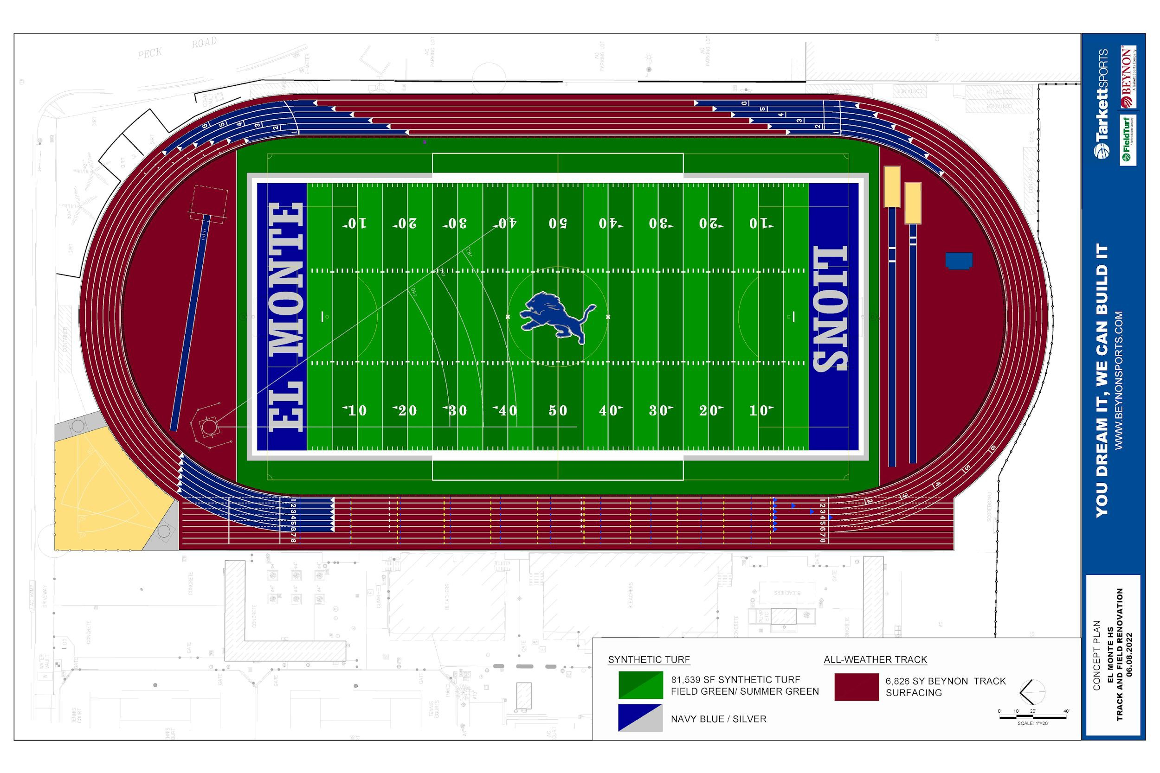
El Monte High School Track and Field Project
HMC Architects hired to design all track & field projects
Project will include new synthetic track & field
HMC has met with stakeholders at El Monte High School to develop design
HMC finalizing conceptual drawings
Project approved by DSA
Project has been bid and will be taken for
board approval on
September 18th
◻ Construction to begin by November

Slide 16
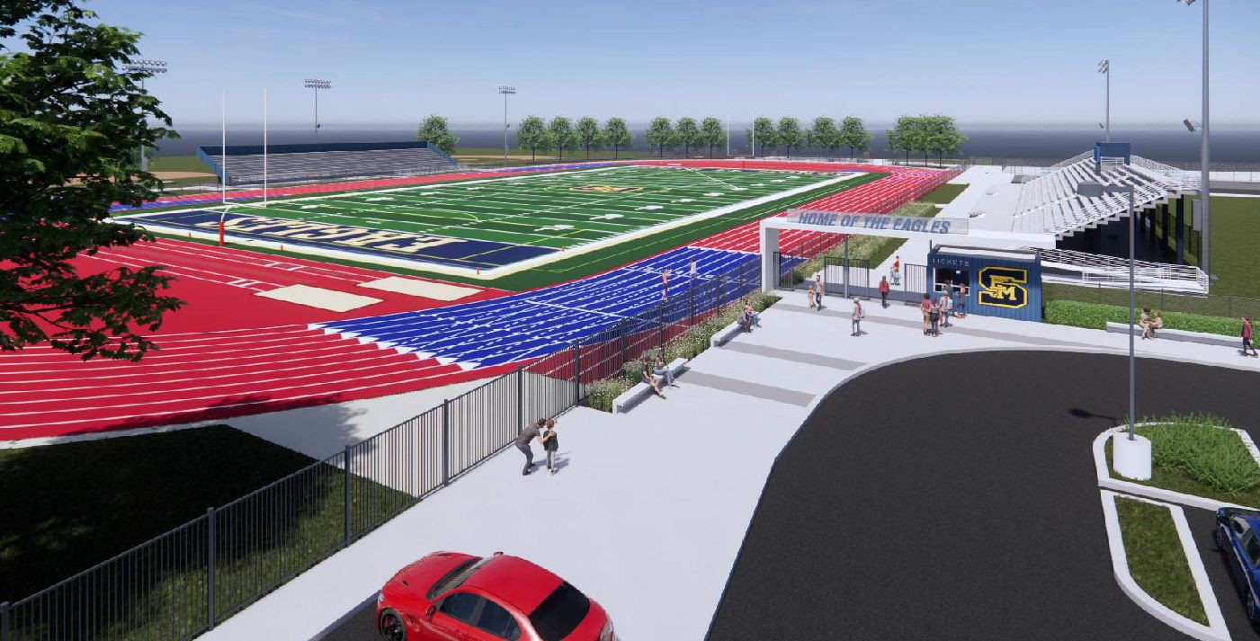
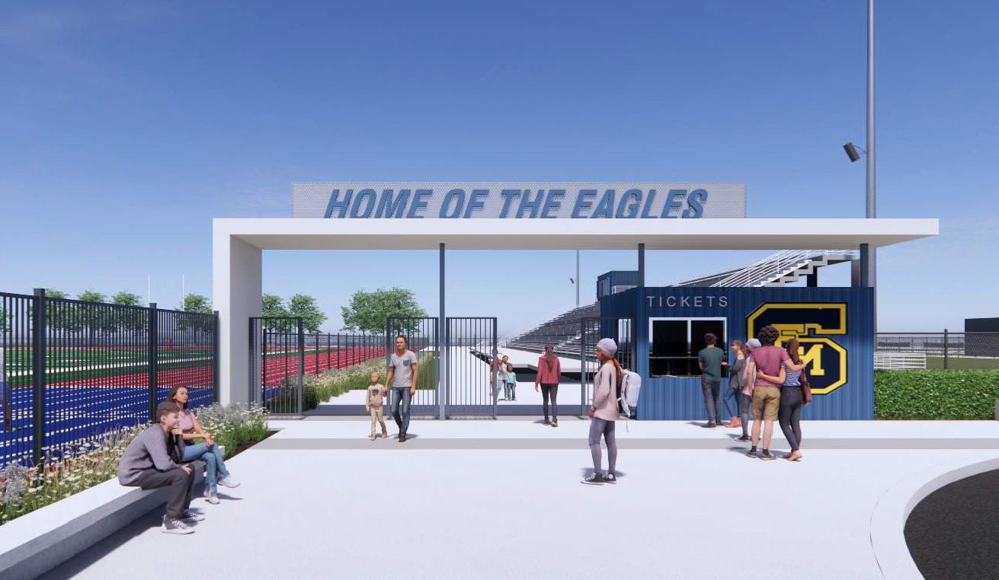
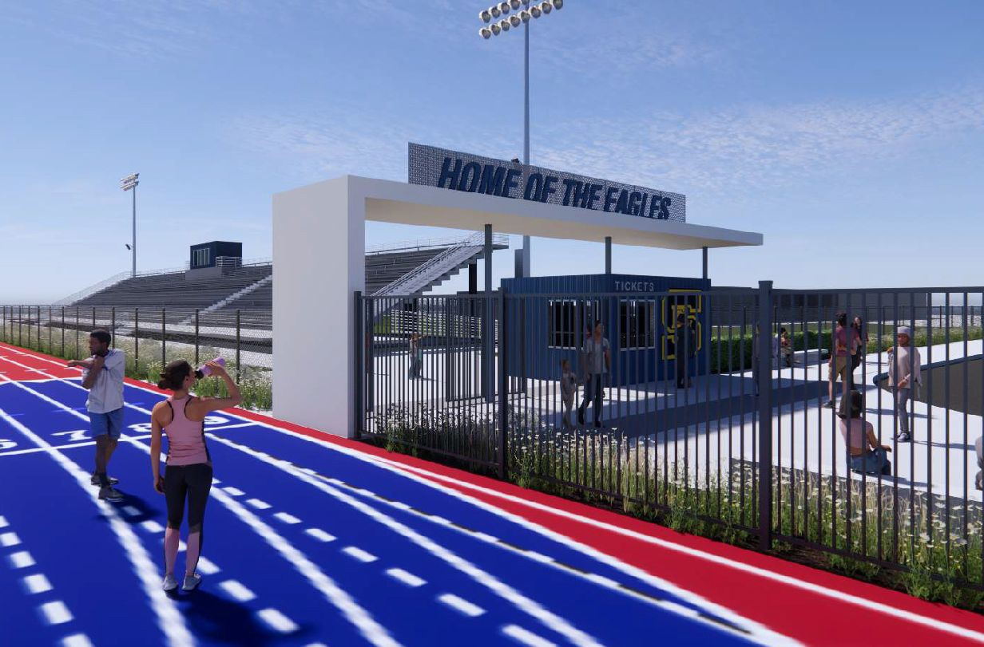
South El Monte High School Track and Field Project
HMC Architects hired to design all track & field projects
Project will include new synthetic track & field and ticketing
HMC has met with stakeholders at South El Monte High School to develop design
HMC finalizing conceptual drawings
Submitted to Army Corps of Engineers for review

Slide 17
ESSER FUNDED PROJECT TIMELINE
ESSER II
Site | Project | start | completion
South El Monte | Sun shade structure | June 2023 | September 2023
Mountain View | Sun shade structure | July 2023 | November 2023
Arroyo | Sun Shade | July 2023 | December 2023
El Monte | Sun Shade | July 2023 | December 2023
Rosemead | Sun Shade | July 2023 | December 2023
ESSER III
Site | Project | start | completion
South El Monte | HVAC in Gym | December 2023 | March 2024
Arroyo | HVAC in Gym & kitchen | January 2024 | September 2024
El Monte | HVAC in Gym | March 2024 | September 2024
Rosemead | HVAC in Gym | January 2024 | September 2024

Slide 18
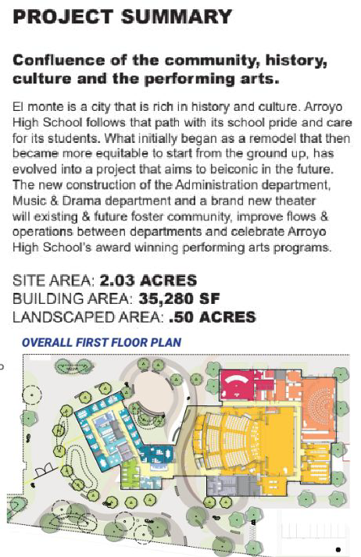
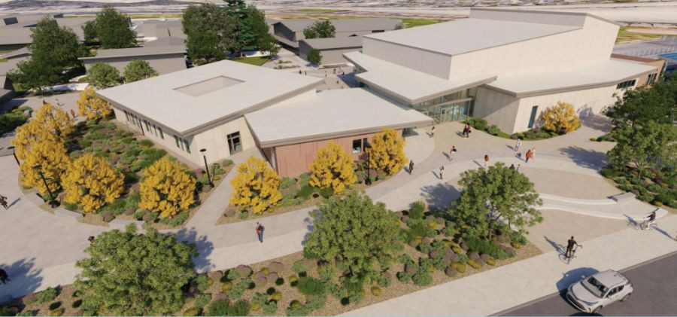
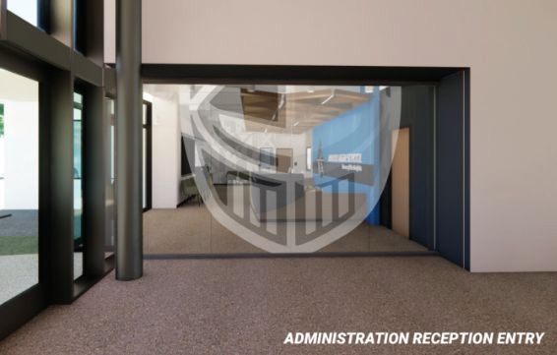
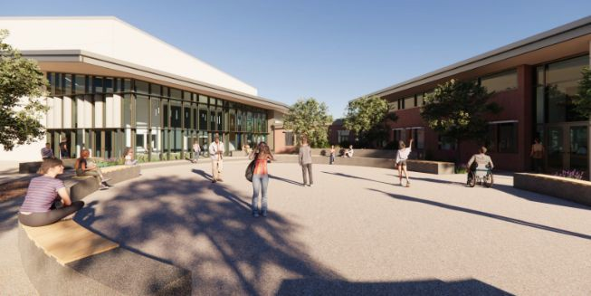
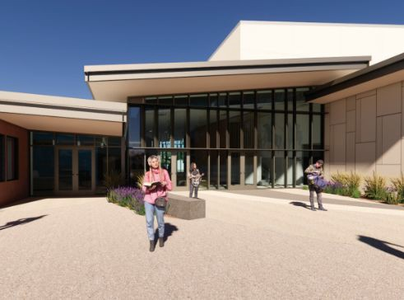
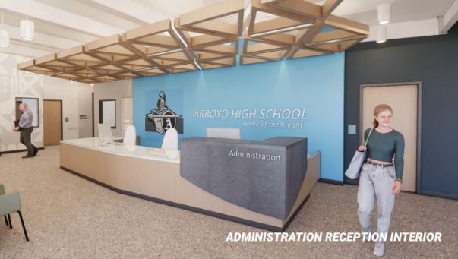
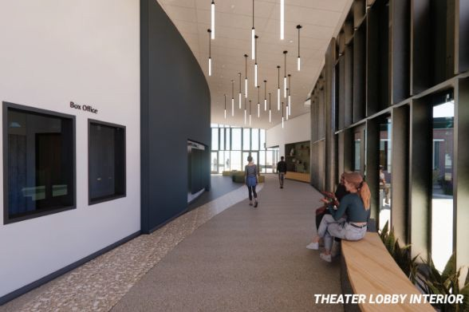
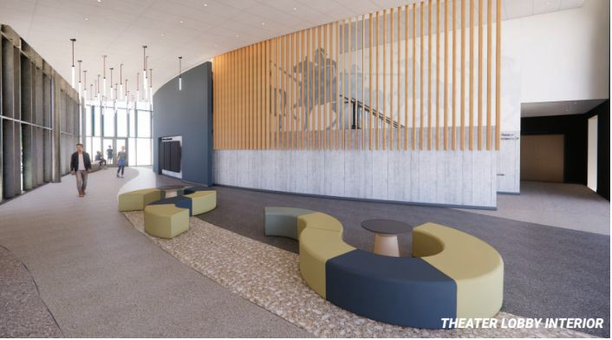
Arroyo High School - New Theatre, Music & Admin. Bldg

Slide 19
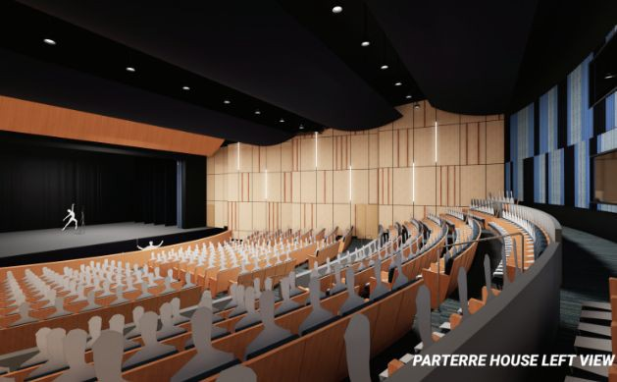
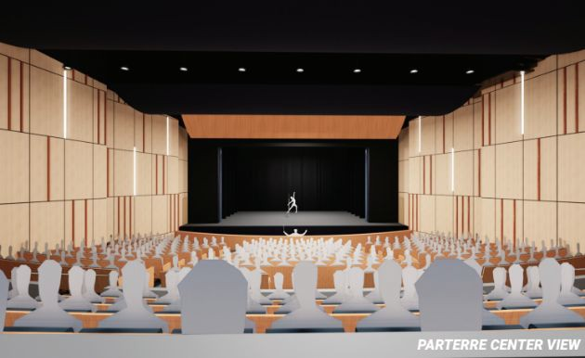
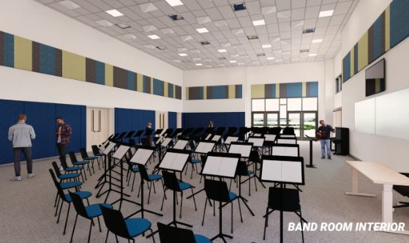
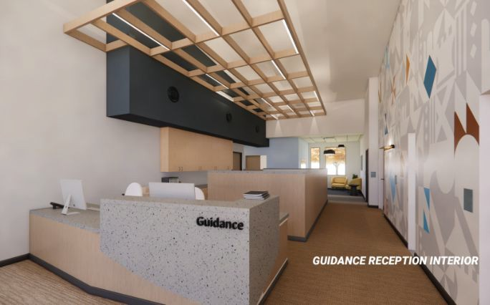
Arroyo High School - New Theatre, Music & Admin. Bldg

Slide 20
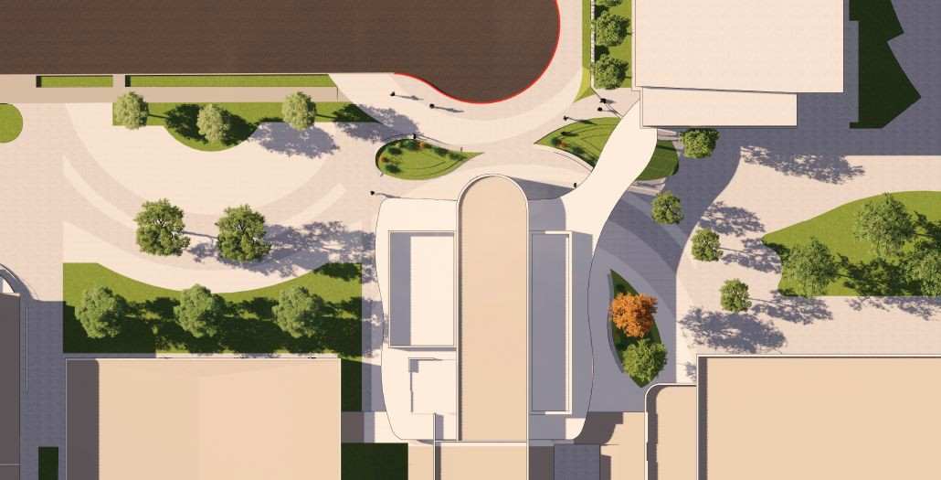
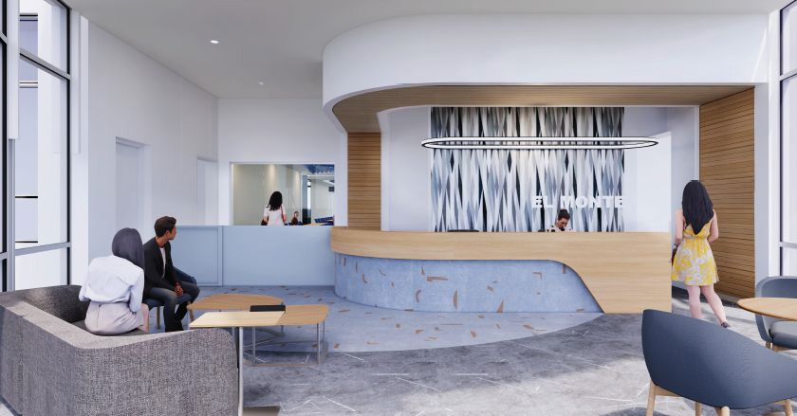
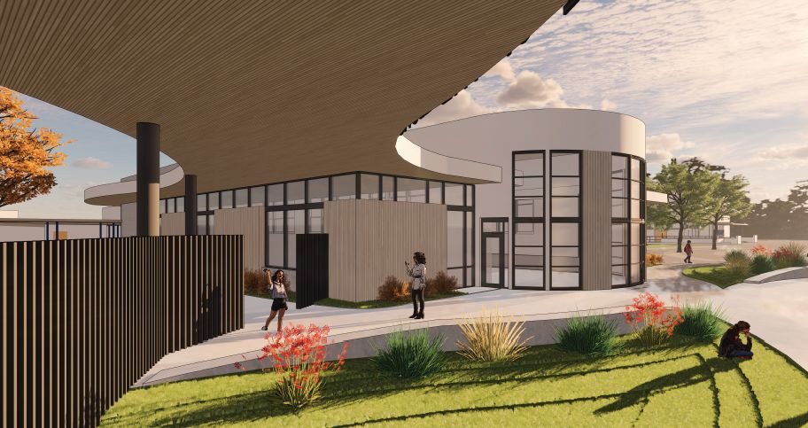
El Monte Modernization Projects
New Welcome Center with Parent Center

Slide 21
El Monte Modernization Projects
Campus wide modernization
New Welcome center with parent center
Modernization of Buildings B, C, E, F, G, H
Modernization of Theatre
Modernization of CTE Classrooms

Slide 22
Rosemead High School Modernization

Slide 23
Rosemead High School Modernization

Slide 24
Solar Project
District Office, El Monte HS & Ledesma HS
Project recently awarded to Engie for $8,610,706.00

